Slide 1


Year 6 Residential Trip 2027
Monday 15th – 19th March
Condover Hall, Shropshire

Slide 2
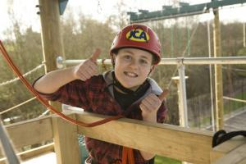
About JCA
Established since 1994, with many years of experience, JCA are experts in providing non-stop education and adventure for school trips and children’s group travel.
JCA have many centres and offer a combination of either one day or residential multi-activity courses from 2-4 nights – promoting education, personal development and fun!

Slide 3
About JCA
Established since 1994, with many years of experience, JCA are experts in providing non-stop education and adventure for school trips and children’s group travel.
JCA have many centres and offer a combination of either one day or residential multi-activity courses from 2-4 nights – promoting education, personal development and fun!
https://www.youtube.com/watch?v=M0VemBvJTGg
https://www.youtube.com/watch?v=wsxwx5Lknzw

Slide 4
So why are we going?
To challenge ourselves in a new environment
To build teamwork/ leadership skills
To build our independence/ raise self-esteem
For fun
To spend time with our friends
= A fantastic way to celebrate being in Year 6

Slide 5
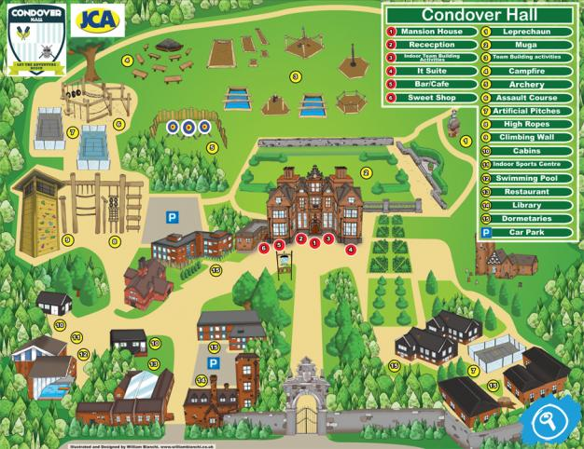
What activities are possible?

Slide 6
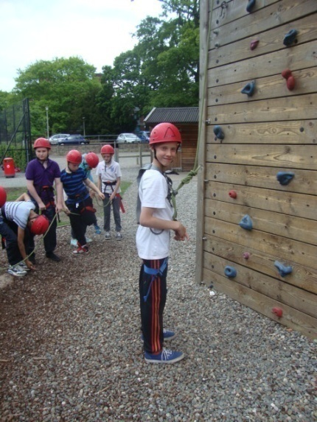
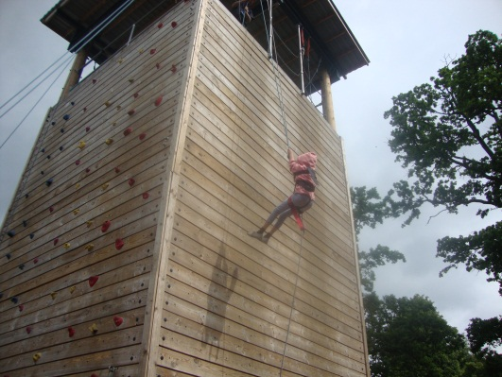
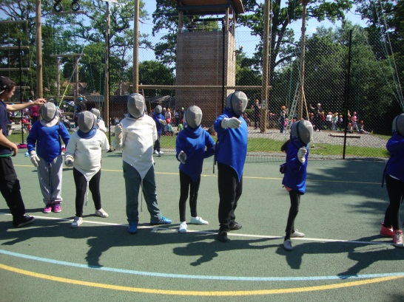
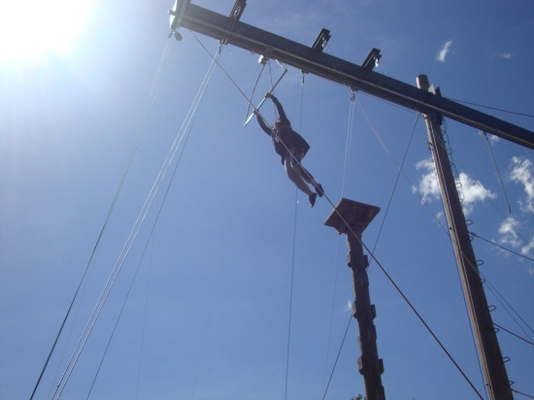
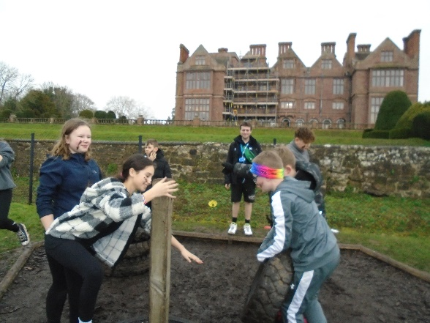
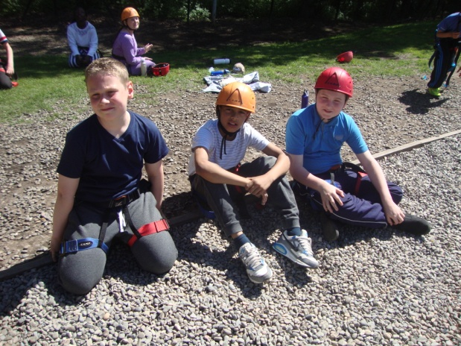
During the Day:
Abseiling
Archery
Tunnelling
Fencing
Orienteering
Rocket Launch
Survival
Kayaking
Raft building
High Ropes
Lazer Maze
And so much more!
Evening Entertainment:
  Film Night
  Disco
  Camp fire
  Mini Olympics

Slide 7
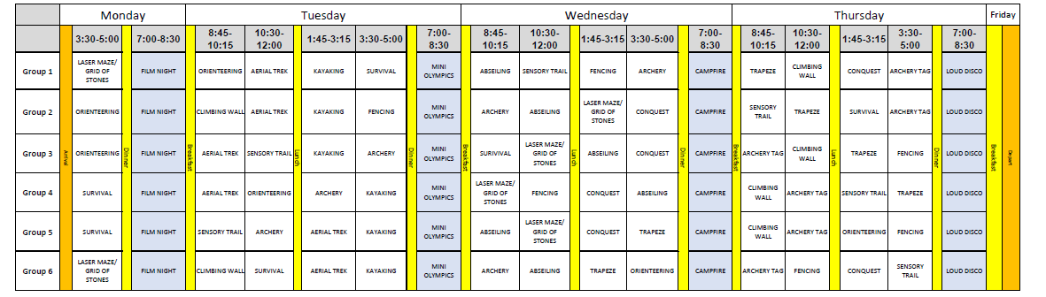
A ‘typical’ week at Condover Hall…

Slide 8
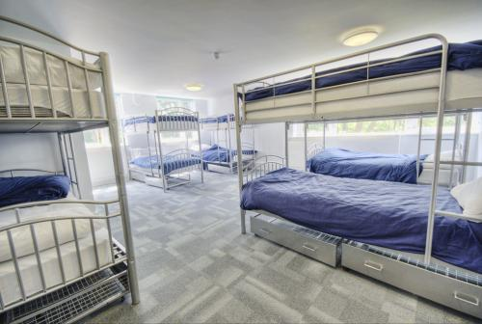
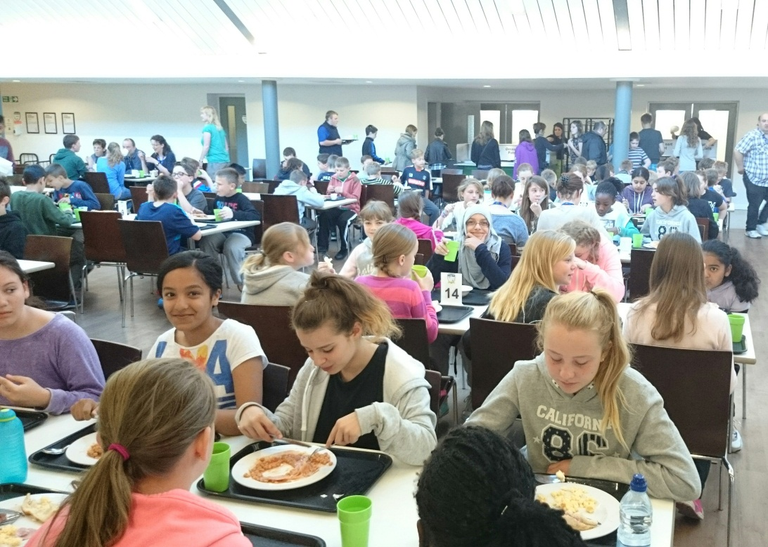
Accommodation at Condover Hall
Dormitories
Dining

Slide 9

What to take…
Clothes
Socks and underwear
Night clothes
Trousers (it’s important that the
students do not wear jeans while
doing the activities for safety and
comfort reasons)
Shorts
T-shirts
Long sleeved top for archery
Tracksuit
Jumpers/sweatshirts/fleeces
Warm coat and waterproof jacket/
Waterproof trousers or trousers
that can get muddy
Disco clothes
Toiletries
Tooth brush
Toothpaste
Sponge
Soap
Shower gel
Hair products, i.e. shampoo/conditioner
Hair ties
Wash bag
Sun cream
Other
Water bottle
Sunglasses
Book to read
Towels
Gloves/hat/cap
Trainers preferably old pairs that can get wet and muddy (two pairs)
Swim kit, extra towel, canvas or plastic shoes for the water (if taking part in water sports)
Maximum £10 spending money

Slide 10
... And what not to bring!
Mobile phones
Electronic gadgets
More than the allocated amount of spending money
Brand new clothes (unless for the disco)
Suitcases that are too big!
Sweets!

Slide 11
Behaviour
The children need to ensure that their behaviour in school warrants us taking them out on a residential trip and being away for 4 nights:
Respect
Courtesy and manners
Ability to listen to and follow instructions
Appropriate use of language towards one another
Appropriate use of hands and feet

Slide 12
Payment schedule
We ask for a securing deposit of £40 per person to be paid by 1st June 2026 to confirm the trip.
An interim deposit of £60 per person to be paid by 30th June 2025.
The final balance of £335 is due in January 2027.
Total cost = approximately £435
Please note that deposits are non-refundable

