Slide 1


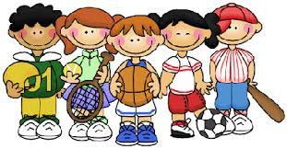
School Clubs and Activities
 | Monday | Tuesday | Wednesday | Thursday | Friday
Before school | Y1 & Y2 Cookery (Mrs Ridley) | Y1, Y2 & Y3 Football (Mr Murgatroyd) Y4, Y5 & Y6 Current Learners Intermediate Violin (Mrs Santana) | Y1, Y2 & Y3 Games - Dodgeball, Boccia, Kurling and Netball (Mr Murgatroyd) | Y4, Y5 & Y6 Table Tennis (Mr Murgatroyd) | Y4, Y5 & Y6 Current Learners Brass Lessons (Mrs Gardner & PHS) Y3, Y4, Y5 & Y6 Glow in the dark Dodgeball (SportsCool)
Lunch time
After school | Y4, Y5 & Y6 Badminton (Mr Murgatroyd) | Y1, Y2 & Y3 Game Making (Jam Coding) | Y4, Y5 & Y6 Street Dance (Abigail, KL Dance) | Y1, Y2 & Y3 Multisports Throwing games, Team work games, Running races etc (Mr Murgatroyd) | Y1, Y2 & Y3 Cheerleading (Abigail, KL Dance)

