Slide 1
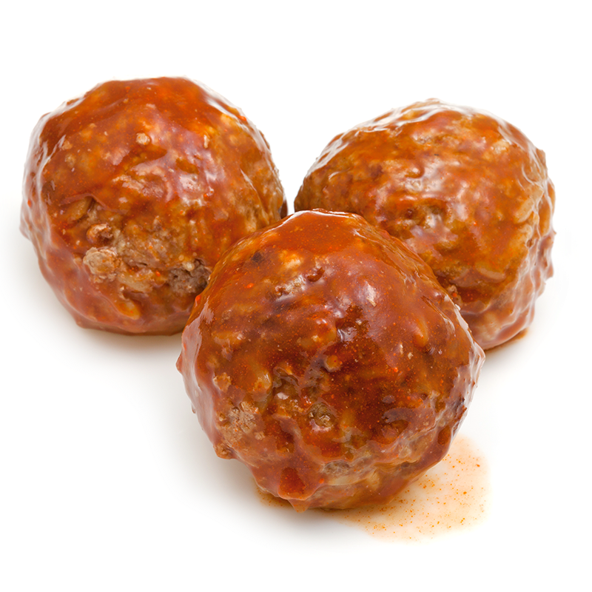
Meatballs
Beef meatballs – fry until brown on the outside
Add:
A tin of chopped tomatoes
2 tbsp tomato puree
1 tbsp garlic puree
1 jar of pizza topping
Chopped onions and peppers
Mixed herbs
A pinch of Cayan pepper
A cup of water
Salt and pepper to taste
Simmer for 20 minutes until the meatballs are cooked through

Slide 2
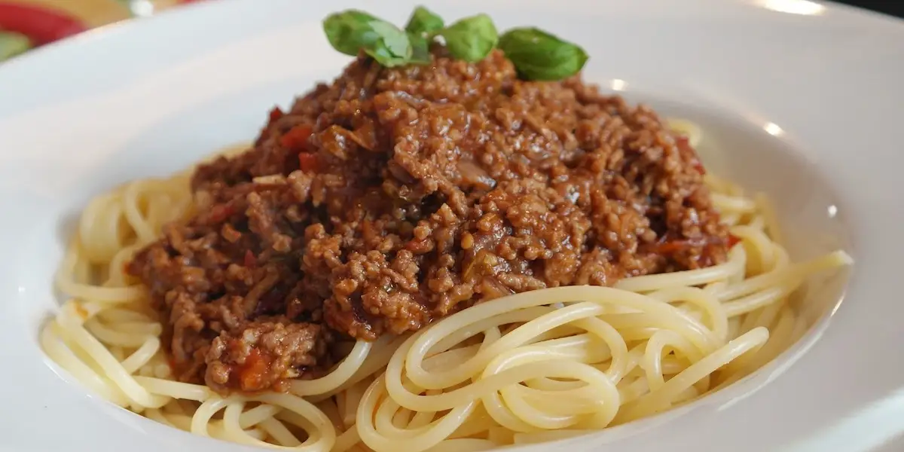
Beef bolognaise
Brown your beef mince in a pan
Add onions and peppers, garlic and tomato puree to taste
Add a tin of chopped tomatoes
Add mixed herbs, salt and pepper
Bring to the boil and simmer until the meat is cooked and the sauce is a good consistency

Slide 3
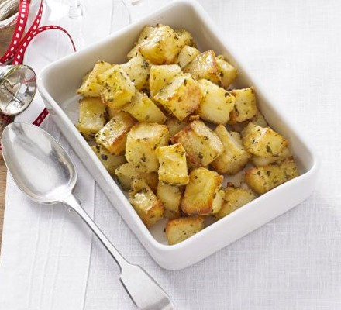
Herby Diced Potatoes
Dice potatoes
Boil for 10mins
Drain and spray with spray oil
Add mixed herbs, salt and pepper and shake well
Put onto a baking tray and cook in the oven for 30 minutes

Slide 4
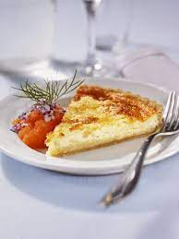
Cheese flan base
8oz plain flower
4oz margarine
Mix into breadcrumb consistency
Add a little water to bind together
Roll out into a dish and blind cook for 15 minutes
Cheese flan filling
Whisk together 3 eggs, quarter of a pint of milk, salt and pepper and 1tsp of mustard
Add cheese (as much as you would like) to pastry case
Then add the liquid on top
Cook in the oven for 20-25 minutes
Cheese Flan

Slide 5
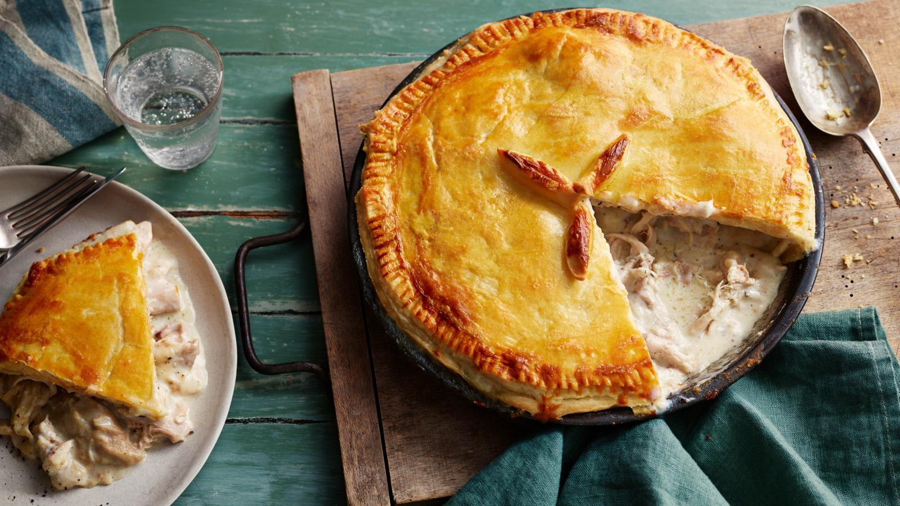
Chicken pie
Make the pastry the same as the base of the cheese flan for the base of the pie
Have puff pastry for the topping
Dice chicken and brown it off in a pan
To make the sauce
Add to pan - 1 pint of milk, salt and pepper, 1oz butter, 1tbsp of mixed herbs, dry chicken stock and bring to the boil
Then add cornflour pre-mixed with water to the milk until it thickens
Add the chicken into the sauce and simmer for 15 minutes
Put it into the cook pie base and then add the puff pastry on top (egg wash the top of the pie)
Cook until golden brown

